Slide 1
Simulation of Light Propagation in Optical Fibers in the GlueX Tagger Microscope
June Yong Yang, Nuclear physics site
Mentor : Dr. Richard Jones

Slide 2
Introduction
My work was to model the propagation of light inside an optical fiber, which is used in a tagger microscope.
The tagger microscope is a crucial part of the GlueX experiment apparatus.

Slide 3
The GlueX Experiment At JLab
GlueX is a particle physics experiment project at the Thomas Jefferson National Accelerator Facility (JLab).
Its purpose is to understand confinement in quantum chromodynamics by mapping the spectrum of exotic mesons(which have never before been observed).
GlueX will use photoproduction (scattering of a real photon on a nucleon), to produce exotic states.
GlueX will start getting data around 2014.

Slide 4
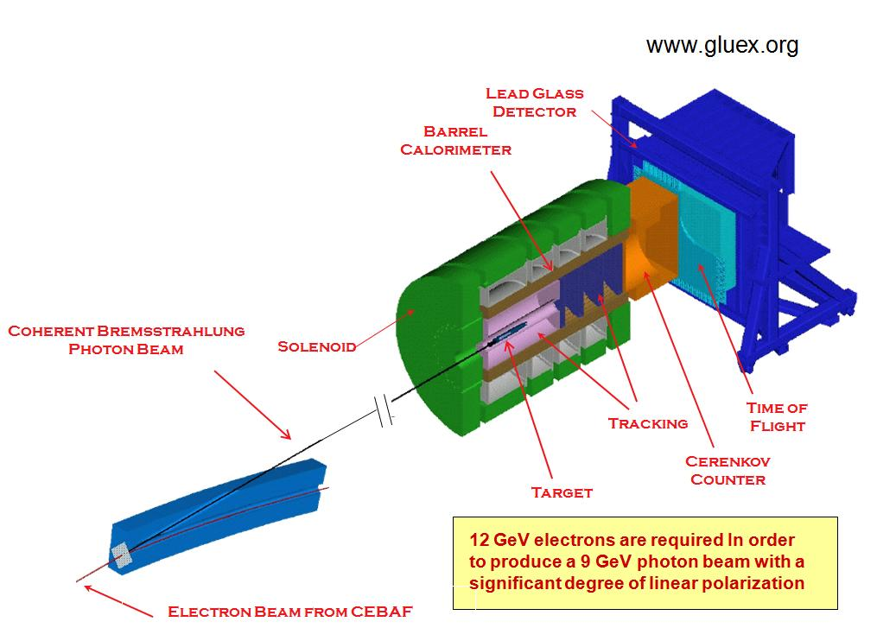
The GlueX Experiment
High energy electron beam(12GeV) is produced by the accelerator.
A diamond lattice is used to generate bremsstrahlung photon beam from the electron beam.
The electron beam is dumped.
The photon beam propagates into the detector and photoproduction occurs.
The detector detects the produced particles.

Slide 5
Photon Tagging
Coherent bremsstrahlung generates photons with various energies.
Since only the photons with energies over a certain value are needed, we must know the energy that each photon holds.
The garbage electron beam is put into a uniform magnetic field.
Electrons are then curved by the field. Since the radius of the curve is related to their energies, we can classify the electrons by their energies.
When an electron is detected by the tagger, it sends a signal to the main particle detector.
The main detector calculates the time delay and records the data.

Slide 6
Photon Tagger And Optical Fibers
Photon Tagger uses scintillating optical fibers to produce signals.
The signal is delivered to the sensor by ordinary optical fibers.
Loss in the fiber is crucial to the accuracy of the tagger’s data.

Slide 7
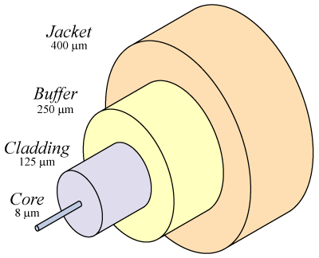
Optical Fibers
A fiber that acts as a pipe that transfers light
The important part : cladding and the core
The index of refraction of the cladding is lower than the index of the core.
Optical fibers use total internal reflection to confine the light inside the fiber.
Step index fiber and graded index fibers.
Single mode fibers and multimode fibers.
Circular fibers and square fibers.

Slide 8
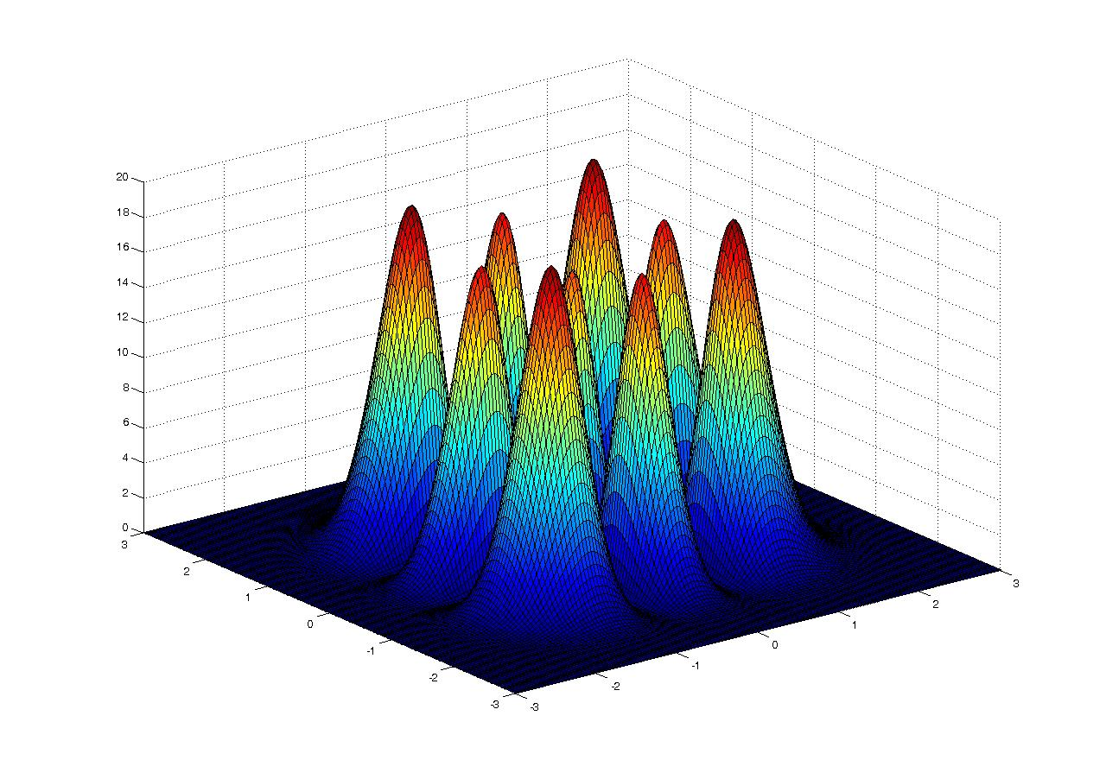
Fiber Modes
Modes are transverse intensity distributions of light inside a fiber.
Modes are the solutions of the electrodynamic conditions inside a fiber.
Light propagates inside a fiber by forming single or several modes.

Slide 9
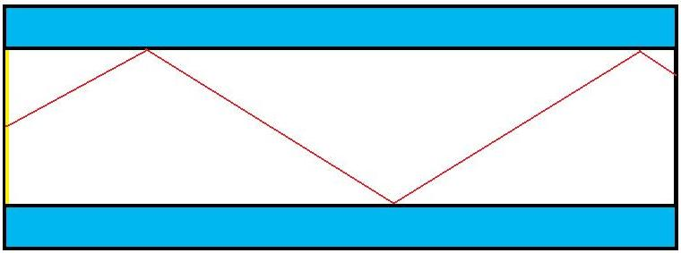
Computer Model
Monte Carlo Method
Shoots random rays into the fiber.
Calculate the Green’s function to the boundary.
Calculate its reflection & refraction properties.
The intensity change is modeled by using probabilities.
The process is repeated.
The phase of the ray is accumulated during the simulation.
As the number of rays diverge, the approximate – precise intensity distribution at the end will show up

Slide 10
Wave Propagation
Using the Green’s function, we can calculate the electric field distribution caused at an arbitrary point by a point source.
The phase of the wave can be calculated by dividing the distance from the source to the point by the wavelength.

Slide 11
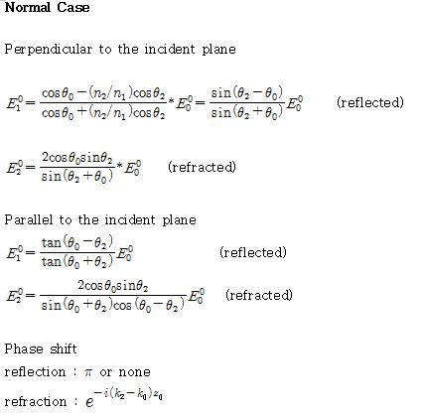
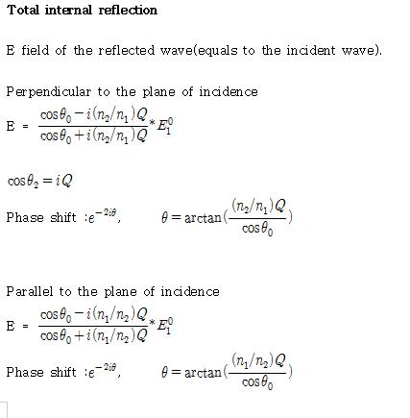
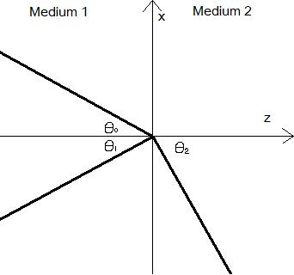
Phase Shifts & Intensity Changes at the Core - Cladding Boundary

Slide 12
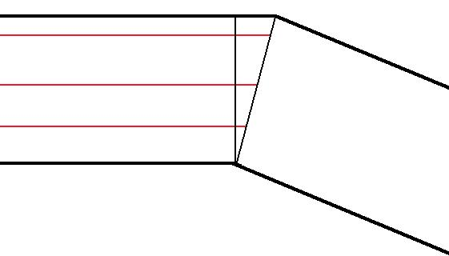
Curving The Fiber
Shifting of phases can give the effect of curving the fiber.
Turning the angle of the rays can make the effect also.

Slide 13
References
1.Classical Electromagnetic Radiation. Mark A. Heald, Jerry B. Marion. 1995. Saunders College Publishing.
2.Classical Electrodynamics. John David Jackson. 1999. John Wiley & Sons, Inc.
3.www.gluex.org
4.www.wikipedia.org

